Slide 1
Data Engineering – Capstone
Project
EMPLOYEE DATA ANALYSIS
FROM 1980-1995
MADE BY:
SIDDHANT JAIN

Slide 2
TABLE OF CONTENT
Business objective
Data used & description
Technology stack used
ER Diagram (data model)
Outputs for different analysis (EDA & ML Model)
Challenges faced

Slide 3
Business Objective
To have an overview of company employee structure in the following years and see various department work layout in those years.
We will have a detailed description of employees working in different departments to fulfil the working needs of the organization hence giving us an overview of net manpower consumption for the organization to perform its workflow
Hence we will also have a detailed overview of manpower expenditure made by the company in those years, giving us a full overview of expenditures made by the company in the following years with adjustments in manpower and inflation rates respectively .
The model will help us understand departmental efficiency behaviour, hence providing us with a consolidated view of manpower used and deployed by the departments, and the flowrate of employee hiring and resignations respectively
Through this, we will be able to analyse the employee behaviour and their average serving time for each department, which will help the organization manage the human resources that they need in their particular department to have smooth operations, hence we will also be able to line up backup resources as we will have a departmental data of employees networking period which will help us predict the employees that might be leaving the department .

Slide 4
Data Set
The Following data were used to perform the desired outcomes(All data files were provided in csv format by the organization)
Titles (titles.csv)
Employees (employees.csv)
Salaries (salaries.csv)
Departments (departments.csv)
Department Managers (dept_manager.csv)
Department Employees (dept_emp.csv)

Slide 5
Data flow description
All csv given by the client were upload to a Linux based cloud system.
All the csv were converted into SQL database tables with following attributes as mentioned in slide 5 and 6.
Sqoop as a middleware we transferred all Tables data as Avro files into HDFS
HDFS (copyFromLocal) we transferred Avro Schema files to hdfs
We created Hive tables and loaded Avro files data into it
Then using Hive tables we performed EDA in Impala and Spark SQL
Using Pyspark Dataframes we did ML Model Building
And created ML Pipelines

Slide 6
Technology stack used
The following techstack was usued to meet the project goals:
MySQL (to create database)
Linux Commands
Sqoop (Transfer data from MySQL Server to HDFS/Hive)
HDFS (to store the data)
Hive (to create database)
Impala (to perform the EDA)
SparkSQL (to perform the EDA)
SparkML (to perform model building)

Slide 7
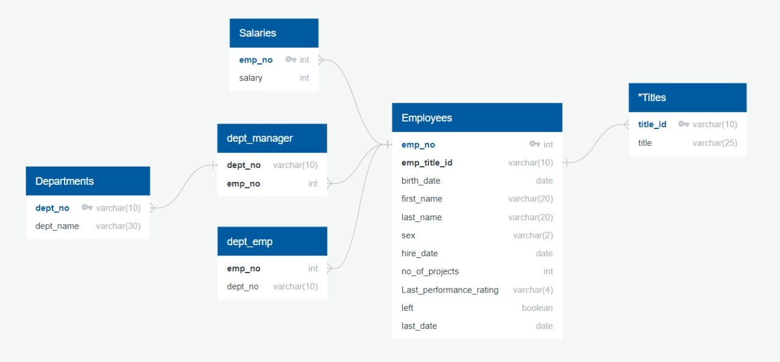
ER Diagram (data model)

Slide 8
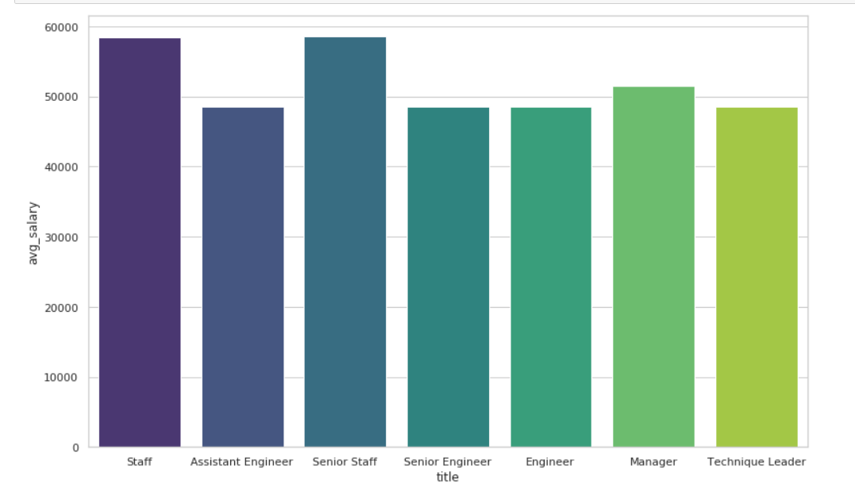
OUTPUTS EDA Average Salary per Title

Slide 9
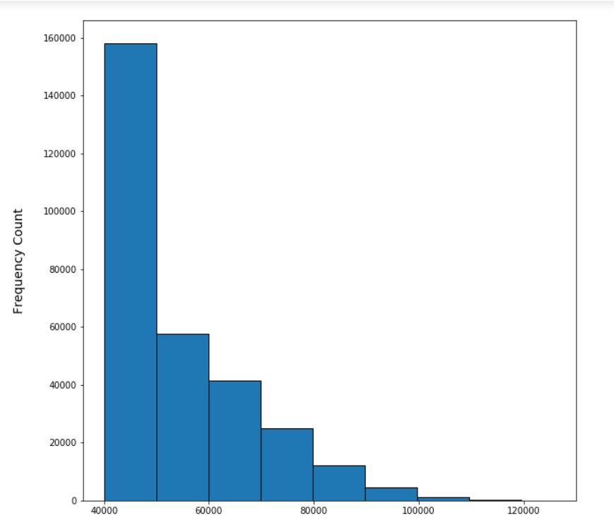
OUTPUTS EDA Salary Distribution

Slide 10
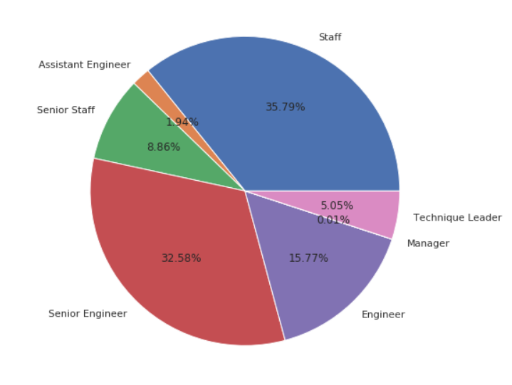
OUTPUTS EDA Employee Acoording to Designation

Slide 11
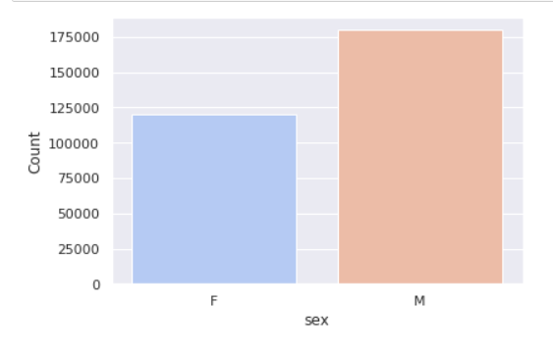
OUTPUTS EDA Employee Gender Distribution

Slide 12
OUTPUTS ML MODEL
model Accuracy | 0.899021

Slide 13
Challenges faced
Importing SQL
Creating ML model
Creating pipelines for ML model

